Slide 1
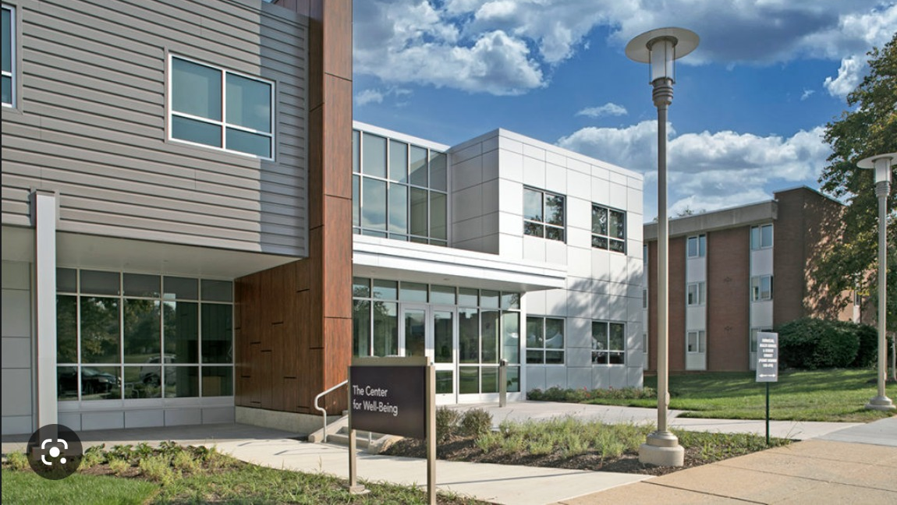
RIH Counseling

Slide 2

Business Need and Requirements
Easy and faster scheduling appointments
Save time and money
Reduced human efforts

Slide 3

Business Value
Increasing the efficiency and effectiveness
Increasing the funding from local health organizations.
Reducing the workload and administrative burden on counselors and support staff

